Slide 1
Modularity Explained
A Community Detection Metric

Slide 2
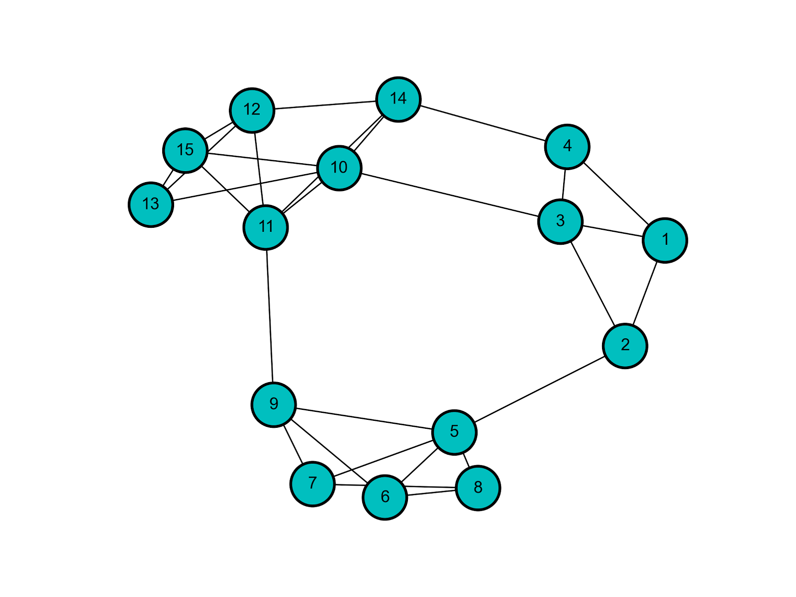
Community Detection
No formal, universally accepted definition of community.
Groups of densely connected nodes that have few inter-group connections.

Slide 3
Community Detection
3 communities or 2 communities?

Slide 4
Community Detection Metrics
Various goodness metrics that evaluate structural properties of communities [1].
Density - fraction of internal edges out of total number of possible edges.
Conductance - fraction of total edge volume that points outside the cluster.
Modularity - the difference of the number of edges in a community and the expected number of edges (assuming you have an identical degree distribution).

Slide 5
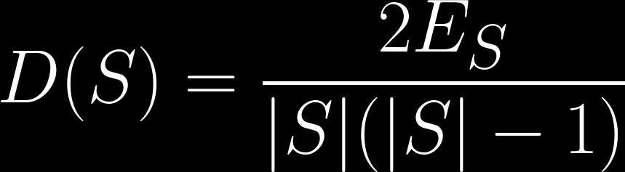
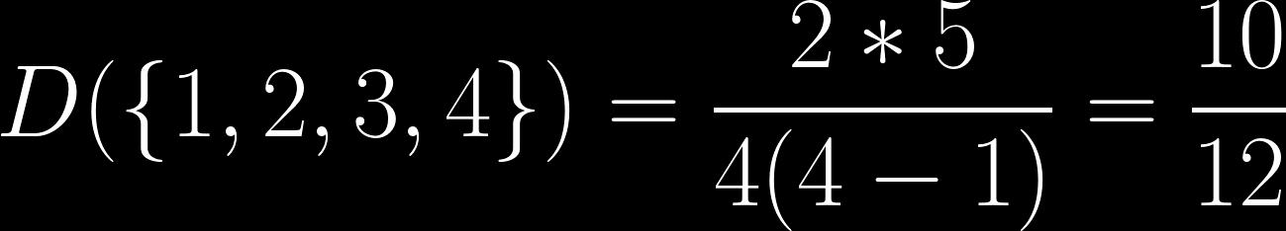
Metric: Density
Measure of internal connectivity.

Slide 6
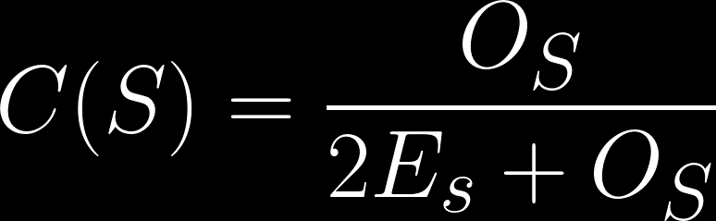
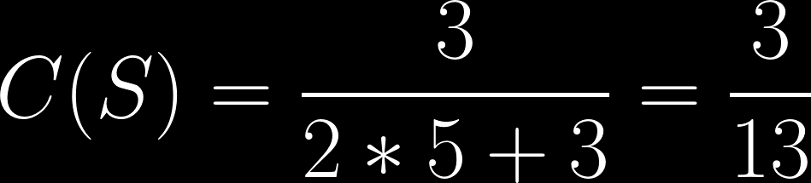
Metric: Conductance
Measure of internal and external connectivity. The fraction of edges pointing outside a community.

Slide 7
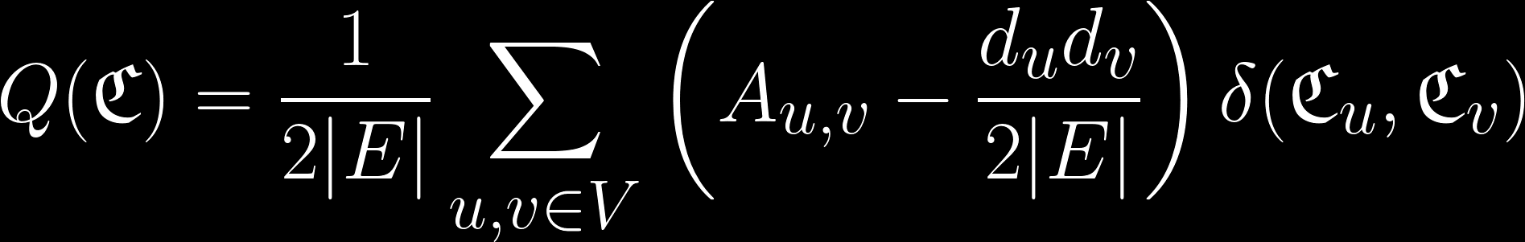
Metric: Modularity
A global metric: defined per-network, not per-community.
Measure of internal and external connectivity. How well the network partitions into modules.
Higher values are better.
Notes:
Q(\mathfrak{C}) = \frac{1}{2|E|}\sum_{u,v\in V}\left ( A_{u,v} - \frac{d_ud_v}{2|E|} \right )\delta(\mathfrak{C}_u, \mathfrak{C}_v)

Slide 8
Metric: Modularity
A global metric: defined per-network, not per-community.
Measure of internal and external connectivity. How well the network partitions into modules.
Higher values are better.
== 1 if community of u is same as community ov v, else 0
Normalize by degree sum
== 1 if adjacent, else 0
Expected number of edges between u and v, based on degrees
For every pair of vertices, add the following…

Slide 9
Modularity Example
1
3
4
2
Q = 1/8 * (
(0 - (2*2) / 8) * 1 + (1 - (2*2) / 8) * 1 + (1 - (2*3) / 8) * 1 + (0 - (2*1) / 8) * 0 +
(1 - (2*2) / 8) * 1 + (0 - (2*2) / 8) * 1 + (1 - (2*3) / 8) * 1 + (0 - (2*1) / 8) * 0 +
(1 - (3*2) / 8) * 1 + (1 - (3*2) / 8) * 1 + (0 - (3*3) / 8) * 1 + (1 - (3*1) / 8) * 0 +
(0 - (1*2) / 8) * 0 + (0 - (1*2) / 8) * 0 + (1 - (1*3) / 8) * 0 + (0 - (1*1) / 8) * 1
) = -0.03125
v=1
v=2
v=3
v=4
u=1
u=2
u=3
u=4

Slide 10
Modularity
3 communities or 2 communities?
Q = 0.500
Q = 0.365

Slide 11
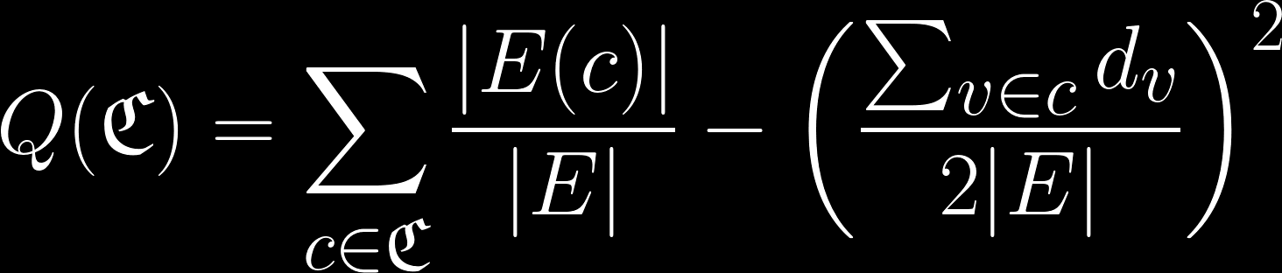
Modularity: Another Equation
Notes:
Q(\mathfrak{C}) = \sum_{c\in\mathfrak{C}}\frac{|E(c)|}{|E|} - \left ( \frac{\sum_{v\in c}d_v}{2|E|} \right )^2

Slide 12
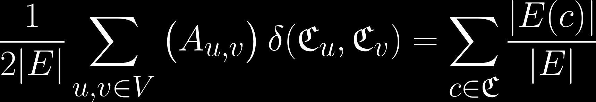
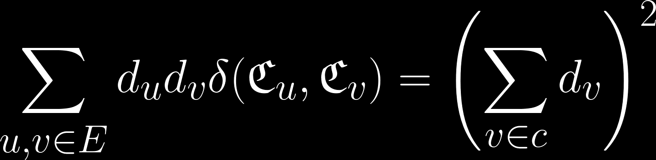
Modularity: Another Equation Derivation
Follows from original equation because…
Notes:
\frac{1}{2|E|}\sum_{u,v\in V}\left ( A_{u,v} \right )\delta(\mathfrak{C}_u, \mathfrak{C}_v) = \sum_{c\in\mathfrak{C}}\frac{|E(c)|}{|E|}
\sum_{u,v\in E}d_ud_v \delta(\mathfrak{C}_u, \mathfrak{C}_v) = \left( \sum_{v\in c}d_v \right )^2

Slide 13
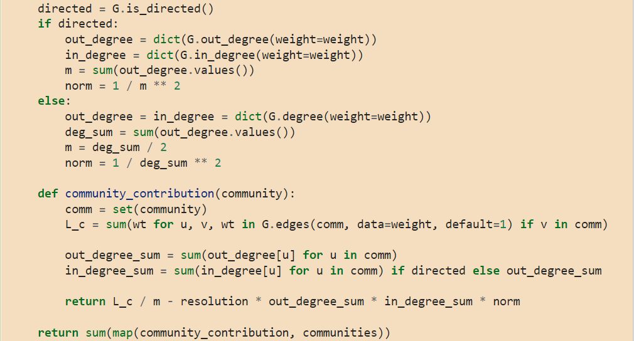
Modularity: NetworkX (v2.6) [2]

Slide 14
Modularity - Values
Modularity bounded in range [-0.5, 1].
All nodes in a single community or all nodes in their own community -> Q=0.
Nonzero values represent deviations from randomness (for better or worse).
“... in practice it is found that a value above about 0.3 is a good indicator of significant community structure in a network.” [3]
Other properties listed in [4]
K3,3
Q = 1 - 1/C (converges to 1)
Q = -0.5

Slide 15
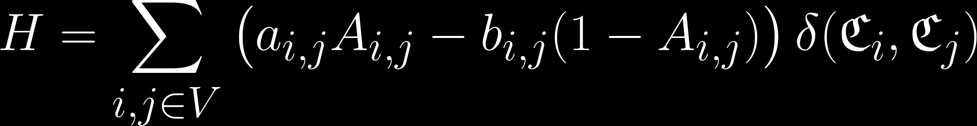
Modularity - Intuition behind the equation
Reward links within communities and penalize missing links within communities [5].
weight
weight
Link within community
Link missing in community

Slide 16
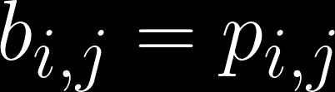
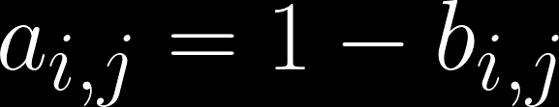
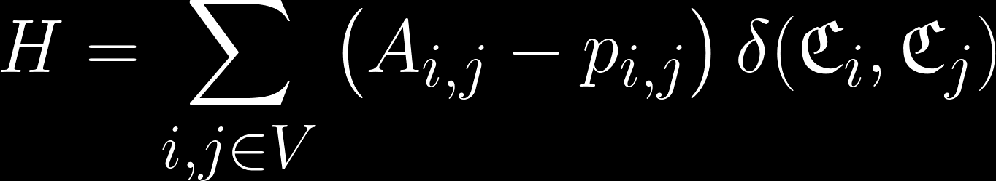
Modularity - Intuition behind the equation
Let:
= the probability of a link between i and j
= the probability of no link between i and j
Notes:
H=\sum_{i,j \in V}\left( a_{i,j}A_{i,j} - b_{i,j}(1-A_{i,j})\right)\delta(\mathfrak{C}_i, \mathfrak{C}_j)

Slide 17
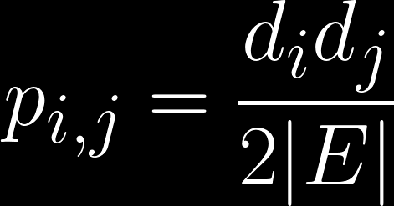
Modularity - Intuition behind the equation
What is the probability of a link between i and j?
i
j

Slide 18
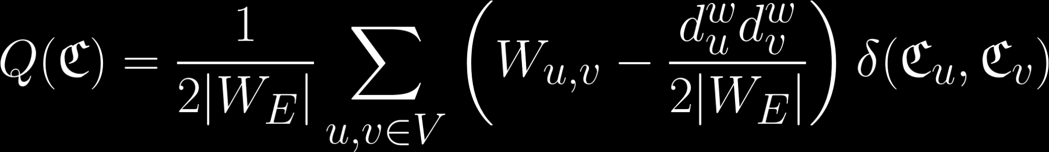
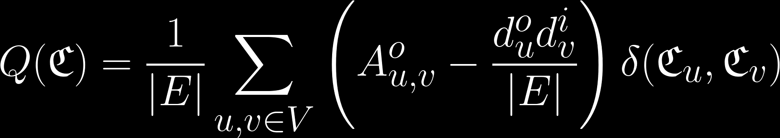
Modularity - Directed and Weighted
Modularity can naturally be extended to weighted and/or directed graphs.
Weighted: (w for weighted)
Directed: (o for outgoing edges, i for incoming edges)
Notes:
Q(\mathfrak{C}) = \frac{1}{2|W_E|}\sum_{u,v\in V}\left ( W_{u,v} - \frac{d^w_ud^w_v}{2|W_E|} \right )\delta(\mathfrak{C}_u, \mathfrak{C}_v)
Q(\mathfrak{C}) = \frac{1}{|E|}\sum_{u,v\in V}\left ( A^o_{u,v} - \frac{d^o_ud^i_v}{|E|} \right )\delta(\mathfrak{C}_u, \mathfrak{C}_v)

Slide 19
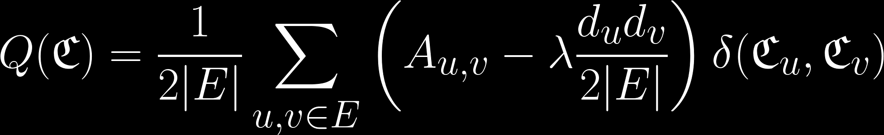
Modularity - Issues
This “null model” assumes that edges could be randomly attached to any other edge in the network.
In a large enough network, even a weak connection could be a sign of a strong correlation.
This bias towards large communities is called the resolution limit.
One way to address this is via a weight on the importance of the null model.

Slide 20
References
Yang J, Leskovec J. Defining and evaluating network communities based on ground-truth. In: ICDM. New York, NY: ACM; 2012, 745–754 https://cs.stanford.edu/~jure/pubs/comscore-icdm12.pdf
https://networkx.org/documentation/stable/_modules/networkx/algorithms/community/quality.html#modularity
Clauset, Aaron, Mark EJ Newman, and Cristopher Moore. Finding community structure in very large networks. https://arxiv.org/pdf/cond-mat/0408187.pdf
Brandes, Ulrik, et al. On finding graph clusterings with maximum modularity. https://citeseerx.ist.psu.edu/viewdoc/download?doi=10.1.1.164.6662&rep=rep1&type=pdf
Traag, Vincent A., Paul Van Dooren, and Yurii Nesterov. "Narrow scope for resolution-limit-free community detection." https://arxiv.org/pdf/1104.3083.pdf

